Slide 1
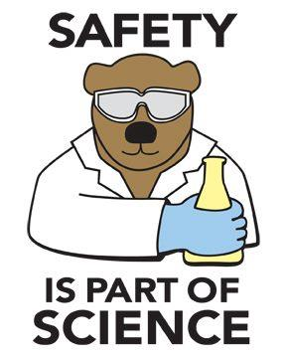
Lab Safety Procedures & Use of Safety Equipment

Slide 2
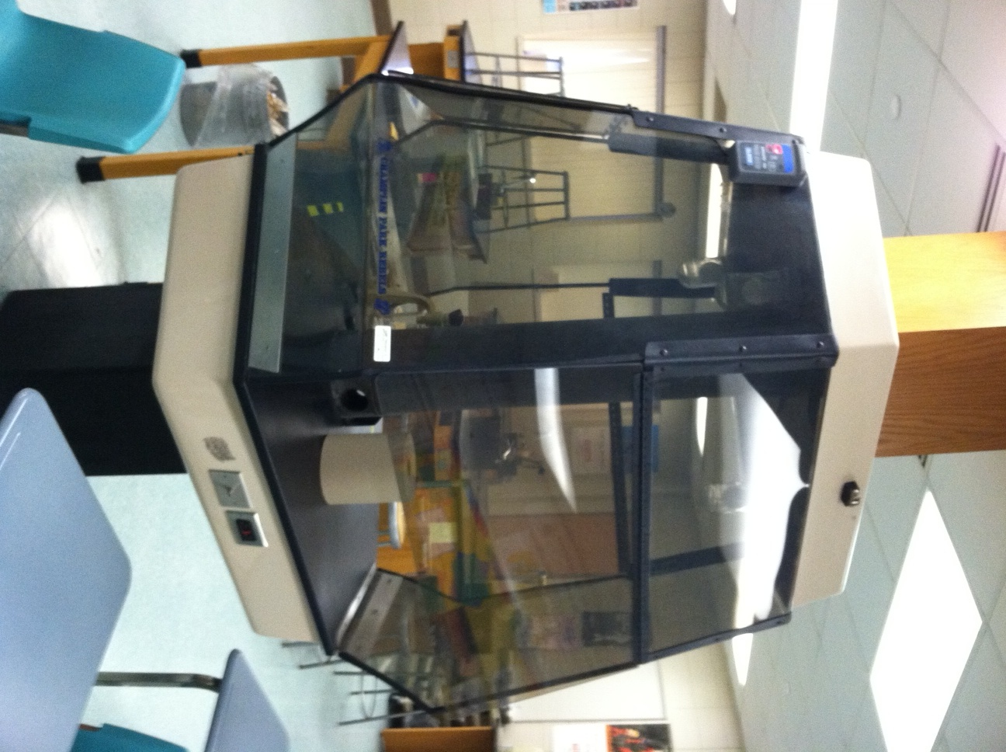
Fume Hood
Use when conducting experiments that involve:
the production of smoke.
the production of poisonous gas.
the release of vapors that are flammable.

Slide 3
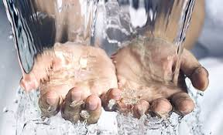
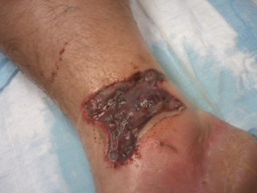
Chemical Spills on Skin
Rinse skin immediately with running water to avoid a chemical burn.
Call teacher over to determine how many minutes you should rinse the affected area.

Slide 4
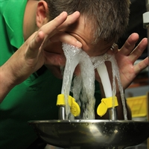
Eye Wash Station

Slide 5
Contact Wearers – You are at even greater risk when you don’t wear your goggles!!!

Slide 6
“SAFETY” Shower
The last person who pulled the safety shower just for fun! They went on a 10 day vacation after they cleaned up Lake Bethke!

Slide 7
Safety Shower

Slide 8
Chemical Spills
Large Spills:
1. Guard the spill and contain the spill with kitty litter.
2. If acid, neutralize with baking soda (sodium bicarbonate).
If not acid, ask teacher if it needs additional treatment.
3. Sweep up and put in garbage can.
Small Spills:
1. If acid, sprinkle with
baking soda
2. Wipe up with
wet paper towel.

Slide 9
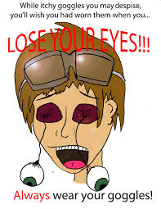
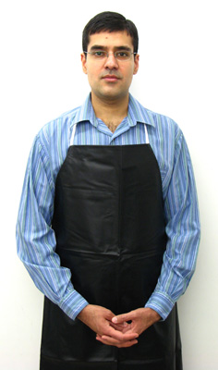
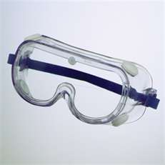
What two pieces of safety gear must you ALWAYS wear when working in lab?
**Goggles will always be sanitized but dirt and grime may remain. To clean, rinse with water and hand soap and DRY WITH THE COTTON TOWEL found on top of the goggle cabinet! Paper towels are coarse and will scratch the lenses.
If you do not wear your apron and you spill on your clothing, we must remove your clothing to rinse the affected skin!

Slide 10
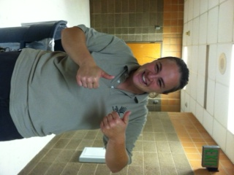
Broken Glass
Amanda

Slide 11
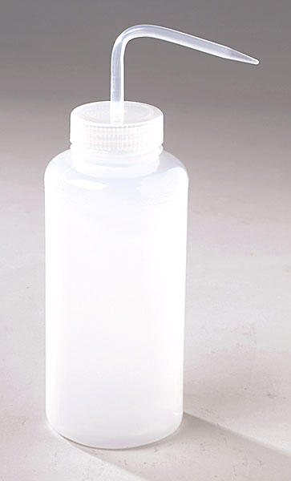
“Prepared Glassware”
Tap water has many contaminates that will interfere with your laboratory results. Tap water must be rinsed away with distilled water.
To prepare glassware:
1) Wash with brush and soapy water
2) Rinse well with tap water
3) Give it a final rinse with a SMALL amount of distilled water from a wash bottle.

